Slide 1
Inheritance and Subclasses in Java
CS 21a: Introduction to Computing I First Semester, 2016-2017

Slide 2
Inheritance
Inheritance: an object-oriented programming language feature that allows for the definition of a class in terms of another class
Another example of a class relationship (besides Aggregation and Association)
In Java, use the extends keyword
Promotes reusability of existing code

Slide 3
Example: SavingsAccount
A savings account is a bank account that earns interest
Attributes
balance
interest rate
Methods
deposit
withdraw
get balance
add interest
SavingsAccount
double balance double interestRate
double getBalance() void deposit(double amount) void withdraw(double amount) void addInterest()

Slide 4
Example: SavingsAccount
If we wrote the class from scratch, the resulting class will be very similar to BankAccount
Actually, the same as BankAccount, except for an additional field and an additional method
Better to extend BankAccount instead

Slide 5
BankAccount, revisited
public class BankAccount {
private double balance;
public BankAccount() {
balance = 0;
}
public void deposit( double amount ) {
balance = balance - amount;
}
public void withdraw( double amount ) {
if( amount <= balance )
balance = balance - amount;
else
System.out.println( "Insufficient balance" );
}
public double getBalance() {
return balance;
}
}

Slide 6
public class SavingsAccount {
private double balance;
private double interestRate;
public SavingsAccount() {
balance = 0;
interestRate = 1.0;
}
public SavingsAccount( double aRate ) {
balance = 0;
interestRate = aRate;
}
public void deposit( double amount ) {
balance = balance - amount;
}
public void withdraw( double amount ) {
// some code omitted...
}
public double getBalance() {
return balance;
}
public void addInterest() {
double interest = balance * interestRate / 100;
balance = balance + interest; // or deposit(interest);
}
}
SavingsAccount.java
Just like BankAccount except for the code in boldface

Slide 7
Using extends
public class SavingsAccount extends BankAccount {
private double interestRate;
public SavingsAccount() {
interestRate = 1.0;
}
public SavingsAccount( double aRate) {
interestRate = aRate;
}
public void addInterest() {
//double interest = balance * interestRate / 100;
double interest = getBalance() * interestRate / 100;
//balance = balance + interest;
deposit( interest );
}
}
SavingsAccount.java
Notice that (public) methods defined in BankAccount (e.g., deposit) can be used within SavingsAccount

Slide 8
Using SavingsAccount Objects
Can call methods defined in BankAccount
SavingsAccount mary = new SavingsAccount();
mary.deposit( 1000 );
System.out.println( "Balance: " + mary.getBalance());
mary.addInterest();
System.out.println( "Balance: " + mary.getBalance());
...and methods defined in SavingsAccount

Slide 9
The Inheritance Relationship
Use inheritance for "is-a" relationships
Examples
A savings account is a bank account
A manager is an employee
A graduate student is a student
A circle is a shape
Diagramming Notation
Bank Account
Savings Account

Slide 10
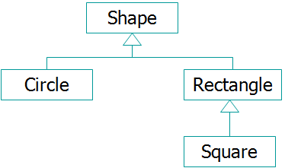
Some Terminology
SavingsAccount is a subclass of BankAccount
BankAccount is the superclass
Inheritance relationships result in a class hierarchy

Slide 11
Superclass Variables and Subclass Objects
Savings accounts are bank accounts so it is possible to have a BankAccount variable point to a SavingsAccount object
But not the other way around
Superclass variables can refer to subclass objects, but not vice versa
BankAccount b1 = new SavingsAccount(); (note: only methods indicated in BankAccount may be invoked on b1)
SavingsAccount b2 = new BankAccount(); (not allowed because a bank account is not necessarily a savings account)
✔
✘

Slide 12
Superclass Variables and Subclass Objects
Consider the following declarations:
BankAccount b = new BankAccount();
SavingsAccount s = new SavingsAccount();
BankAccount t = new SavingsAccount();
SavingsAccount z = new BankAccount();
✔
✔
✔
✘

Slide 13
Superclass Variables and Subclass Objects
Which method calls are valid?
b.withdraw( 100 );
b.addInterest();
s.withdraw( 100 );
s.addInterest();
t.withdraw( 100 );
t.addInterest();
calls BankAccount's withdraw
will not compile
calls BankAccount's withdraw
calls SavingsAccount's addInterest
calls BankAccount's withdraw
will not compile (even though t refers to a SavingsAccount)

Slide 14
Example: CheckingAccount
Define a checking account as a bank account that "counts" transactions carried out (deposit and withdraw transactions), and deducts a transaction fee for each transaction beyond the third transaction
Fees are deducted through a deductFees() method, which resets the transaction count
How do we write this class?

Slide 15
The CheckingAccount Class
If we wrote this class from scratch:
Same as BankAccount, but with an int transactionCount field
deposit and withdraw methods begin with the statement transactionCount++; and proceeds just like in BankAccount
getBalance method is as it was with BankAccount
deductFees method computes and deducts fees
Inheritance not as useful yet, because all methods except getBalance are different from the methods in BankAccount

Slide 16
Method Overriding
In the subclass, a method with the same signature (in the superclass) can have a definition different from that of the superclass
User super.methodName(...) to call the superclass' method
When calling that method for an object of that class, the subclass' method takes precedence over the superclass' method

Slide 17
Method Overriding and super
public class CheckingAccount {
private double balance;
private int transactionCount;
// ...
public void deposit( double amount ) {
transactionCount++;
balance = balance + amount;
}
public void withdraw( double amount ) {
transactionCount++;
if( amount <= balance )
balance = balance - amount;
else
// ..
}
// ...
}
Methods can be overridden
Use super to call a superclass' original method ("extending" a method)
public class CheckingAccount extends BankAccount{
private int transactionCount;
// ...
public void deposit( double amount ) {
transactionCount++;
super.deposit( amount );
}
public void withdraw( double amount ) {
transactionCount++;
super.withdraw( amount );
}
// ...
}

Slide 18
Method Overriding and Dynamic Binding
Suppose BankAccount b = new BankAccount(); CheckingAccount c = new CheckingAccount(); BankAccount d = new CheckingAccount();
Which withdraw() method is called? b.withdraw( 100 ); BankAccount's c.withdraw( 100 ); CheckingAccount's d.withdraw( 100 ); CheckingAccount's
Dynamic binding prevails in the d.withdraw(); call
The method appropriate to the object is always called

Slide 19
Inheritance and Constructors
public class BankAccount {
private double balance;
public BankAccount() {
balance = 0;
}
public BankAccount( double initBal ) {
balance = initBal;
}
// ...
}
CheckingAccount c =
new CheckingAccount();
Which of the constructors is called?
public class CheckingAccount extends BankAccount{
private int transactionCount;
public CheckingAccount() {
transactionCount = 0;
}
// ...
}

Slide 20
Inheritance and Constructors
CheckingAccount c = new CheckingAccount();
In the above statement, CheckingAccount's (default) constructor is called
Since CheckingAccount is a BankAccount, a BankAccount constructor should also be called
Which one?
Answer: the default constructor
Note that BankAccount() is called before CheckingAccount()
What if we want a particular constructor of a superclass to be called?

Slide 21
Incorrect Attempt
We want CheckingAccount c = new CheckingAccount(1000); to create an account with an initial balance of 1000
public class CheckingAccount extends BankAccount {
private int transactionCount;
public CheckingAccount() {
transactionCount = 0;
}
public CheckingAccount( double initBal ) {
transactionCount = 0;
}
// ...
}
This will still call BankAccount(), not BankAccount(1000)

Slide 22
Using super
super(...) indicates which superclass constructor will be called
If not indicated, it defaults to super() with no parameters
Call to super(...) should be the first line in the subclass' constructor
public class CheckingAccount extends BankAccount {
private int transactionCount;
public CheckingAccount() {
transactionCount = 0;
}
public CheckingAccount( double initBal ) {
super( initBal );
transactionCount = 0;
}
// ...
}
Implicitly calls "super();" or BankAccount()
Calls a particular constructor, BankAccount(double)

Slide 23
Object Arrays and Inheritance
Suppose Employee is a superclass, then Manager and Secretary are subclasses of Employee
An Employee array can have its elements refer to different kinds of objects
Can use a for statement to call the same method on the different objects
Allows the program to view the objects in a uniform way

Slide 24
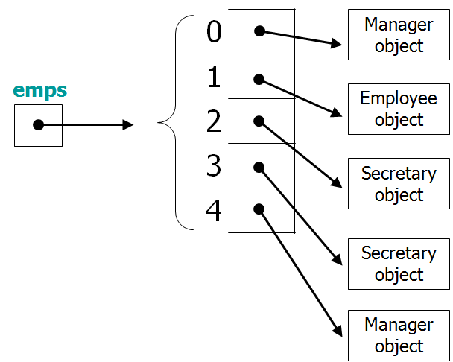
Object Arrays and Inheritance
Employee[] emps;
for ( int i = 0; i < 5; i++ )
emps[i].increaseSalary();

Slide 25
Summary
Use inheritance for similar types of objects
Common characteristics and behavior are placed in the superclass
Subclasses share or inherit superclass' characteristics and behavior
Behavior can be overridden; use super.methodName(...) to invoke a superclass' method when "extending" a method
User super(...) to ensure the correct superclass constructor is called
Other options in Java: abstract classes and interfaces

